Slide 1
Nivelul Aplicaţie
Transferul de fişiere (FTP)
Protocoale de comunicaţie - Curs 11

Slide 2
Cuprins
Interfata linie-de-comanda si interfata grafica
Modelul FTP
O sesiune FTP
Conexiunea de date
Transfer FTP intre doua servere
Securitatea
Protocoale de comunicaţie - Curs 11

Slide 3
File Transfer Protocol
Standard pentru transfer de fisiere (RFC959)
  Protocol independent de SO si de hardware
Protocolul permite:
  Transferul unor fisiere oarecare
    intre utilizator si server
    intre doua servere
  Listarea continutului unui director
  Modificarea directorului curent
  Gestionarea restrictiilor de acces
Poate rula interactiv sau automat
Precede TCP/IP, a fost adaptat ulterior la TCP/IP
Protocoale de comunicaţie - Curs 11

Slide 4
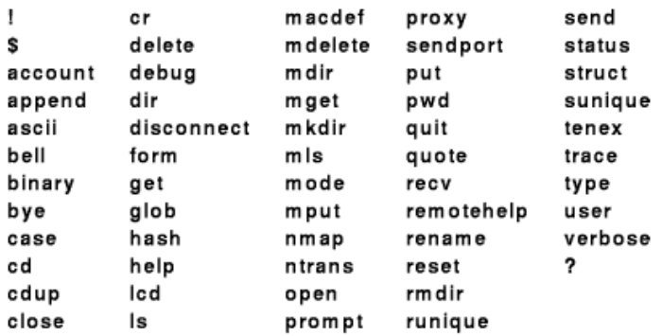
Interfata linie-de-comanda cu utilizatorul
Nu e standardizata, dar
Interfata utilizator din BSD UNIX este standard de facto
Nu sunt comenzi de protocol FTP!
Protocoale de comunicaţie - Curs 11
Notes:
BSD = Berkeley Software Distribution

Slide 5
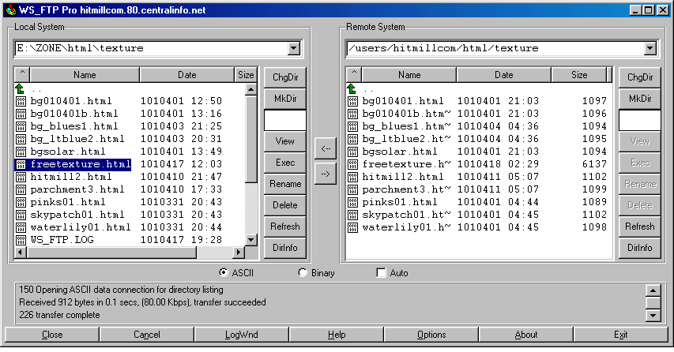
Interfata grafica WS_FTP
Protocoale de comunicaţie - Curs 11

Slide 6
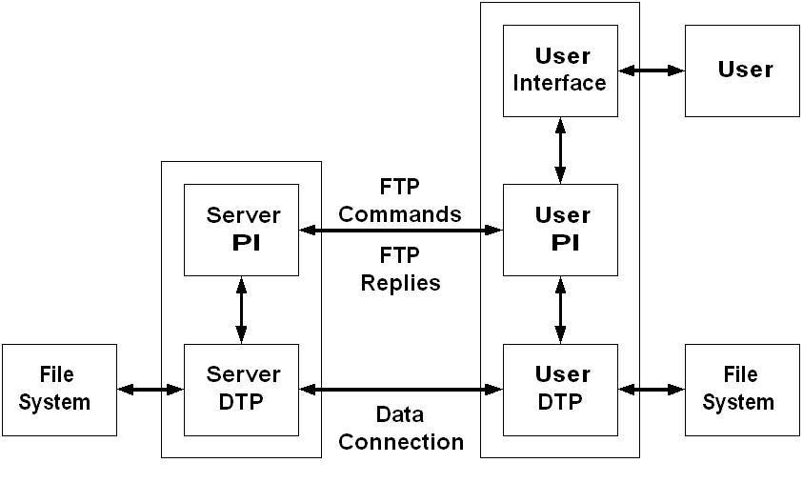
Modelul FTP
Are doua conexiuni
- control - pentru comenzi si raspunsuri
  User PI – User Protocol Interpreter
    initiaza conexiunea de control (lucreaza dupa protocolul telnet)
    genereaza comenzi FTP
  Server PI – Server Protocol Interpreter
    genereaza raspunsuri FTP
- date - pentru transmisie / receptie simultana
User DTP – User Data Transfer Protocol
Server DTP – Server Data Transfer Protocol
Protocoale de comunicaţie - Curs 11
Notes:
In the model described in Figure 1, the user-protocol interpreter initiates the control connection. The control connection follows the Telnet protocol. At the initiation of the user, standard FTP commands are generated by the user-PI and transmitted to the server process via the control connection. (The user may establish a direct control connection to the server-FTP, from a TAC terminal for example, and generate standard FTP commands independently, bypassing the user-FTP process.) Standard replies are sent from the server-PI to the user-PI over the control connection in response to the commands.
The FTP commands specify the parameters for the data connection (data port, transfer mode, representation type, and structure) and the nature of file system operation (store, retrieve, append, delete, etc.). The user-DTP or its designate should "listen" on the specified data port, and the server initiate the data connection and data transfer in accordance with the specified parameters. It should be noted that the data port need not be in the same host that initiates the FTP commands via the control connection, but the user or the user-FTP process must ensure a "listen" on the specified data port. It ought to also be noted that the data connection may be used for simultaneous sending and receiving.

Slide 7
Cateva Comenzi FTP
Comanda Descriere
ABOR Abort proces de conexiune de date
ALLO <bytes> Aloca spatiu fisier pe server
CWD <dir path> Schimba director de lucru pe server
DELE <filename> Sterge fisier specificat, pe server
MODE <mode> Mod de transfer (S=stream, B=block,
C=compressed).
MKD <directory> Creaza director specificat, pe server
QUIT De-logheaza de pe server
TYPE <data type> Tip date (A-ASCII, E-EBCDIC, B-binar)
USER <username> username pentru login
PASS <password> parola pentru login
Format Comenzi: 3-4 caractere plus parametri
Protocoale de comunicaţie - Curs 11

Slide 8
Cateva Raspunsuri FTP
Raspuns Descriere
150 Deschide conexiunea
200 OK
220 Serviciu pregatit
221 De-logare retea
226 Inchide conexiunea de date
250 Actiune terminata
Raspuns: cod numeric & blanc & text descriptiv
Protocoale de comunicaţie - Curs 11

Slide 9
ksh$ /usr/bin/ftp
ftp> open ftp.acmemail.example.com
Connected to ftp.acmemail.example.com (172.16.62.36).
220 Hello, this is the Acme Mail Service.
Name (ftp.acmemail.example.com:root): MB1234
331 Password required to access user account MB1234.
Password: QXJ4Z2AF
230 Logged in.
ftp> cd Bills
250 "/home/MB1234/Bills" is new working directory.
ftp> ls
200 PORT command successful.
150 Opening ASCII mode data connection for /bin/ls.
-rw-r--r-- 1 ftpuser ftpusers 14886 Dec 3 15:22 Acmemail.TXT
-rw-r--r-- 1 ftpuser ftpusers 317000 Dec 4 17:40 Yoyodyne.TXT
226 Listing completed.
O sesiune FTP
mesajele introduse de utilizator sunt reprezentate ingrosat
Dupa logare, utilizatorul:
schimba directorul distant
listeaza continutul
Protocoale de comunicaţie - Curs 11

Slide 10
Sesiune FTP (continuare)
ftp> get Yoyodyne.TXT
local: Yoyodyne.TXT remote: Yoyodyne.TXT
200 PORT command successful.
150 Opening ASCII mode data connection for Yoyodyne.TXT.
226 Transfer completed.
317000 bytes received in 0.0262 secs (1.2e+04 Kbytes/sec)
ftp> quit
221 Goodbye.
descarca un fisier
inchide conexiunea
Protocoale de comunicaţie - Curs 11

Slide 11
Conexiunea de date
Serverul la distanta accepta conexiune de control de la client
Se stabileste apoi conexiunea de date – metode:
Activa – serverul (activ) se conecteaza la client
clientul specifica pe conexiunea de control o adresa si un port;
serverul initiaza conexiunea de date (ex. port 1931, adresa 192.168.1.2)
  Client: PORT 192,168,1,2,7,139
  Server: 200 PORT command successful
  Server: initiaza conexiunea de date la portul specificat de client
  Client : confirma
Protocoale de comunicaţie - Curs 11

Slide 12
Conexiunea de date
Pasiva – clientul initiaza conexiunea cu serverul (pasiv)
  clientul cere, pe conexiunea de control, serverului sa asculte la o adresa si un port (care nu este portul sau standard);
  serverul comunica adresa si portul (ex. port 3439, adresa 172.16.62.36);
  Client: PASV
  Server: Entering Passive Mode (172,16,62,36,13,111)
  Client: initiaza conexiunea de date la portul specificat de server
  Server: confirma
Protocoale de comunicaţie - Curs 11

Slide 13
Transfer FTP intre doua servere
Control +---------------+ Control
------------->| User-FTP |<------------
| | User-PI | |
| | "C" | |
V +---------------+ V
+----------------+ +-----------------+
| Server-FTP | Data Connection | Server-FTP |
| "A" |<---------------------->| "B" |
+----------------+ Port (A) Port (B) +-----------------+
User-PI - Server A User-PI - Server B
------------------------- -------------------------
C->A : Connect C->B : Connect
C->A : PASV
A->C : 227 Entering Passive Mode A1,A2,A3,A4,a1,a2
C->B : PORT A1,A2,A3,A4,a1,a2
B->C : 200 Okay
C->A : STOR file C->B : RETR file
B->A : Connect to HOST-A, PORT-a
Protocoale de comunicaţie - Curs 11

Slide 14
Securitate
FTP transmite user name si password in clar
FTP over SSH
  Transmite password criptat
SFTP - SSH File Transfer Protocol
  Securitate pentru date
  Presupune ca serverul a autentificat utilizatorul
bbFTP
  Securizeaza user name si password
  Utilizat ne-interactiv (shell script)
  Permite stream-uri paralele de date
  Compresie on-the-fly
  Bun pentru volume mari (> 2GB)
Protocoale de comunicaţie - Curs 11

